Slide 1

Netflix SQL Data Analysis

Slide 2
SQL Queries

Slide 3
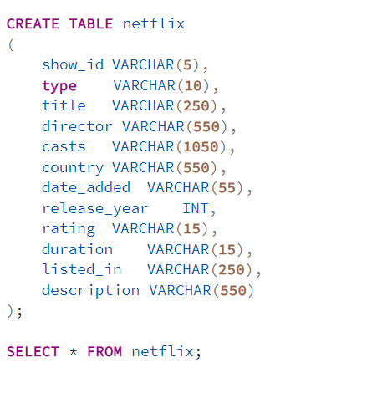
Schemas
1- Netflix table

Slide 4
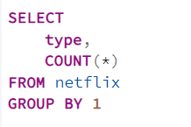
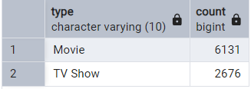
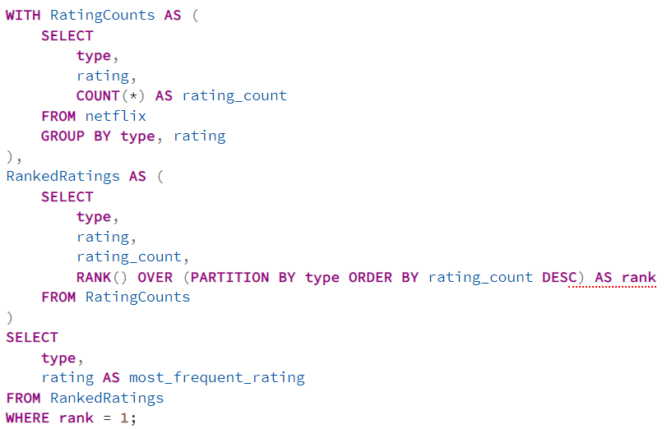
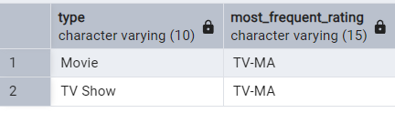
SQL Queries
1) Count the number of Movies vs TV Shows
2) Find the most common rating for movies and TV shows

Slide 5
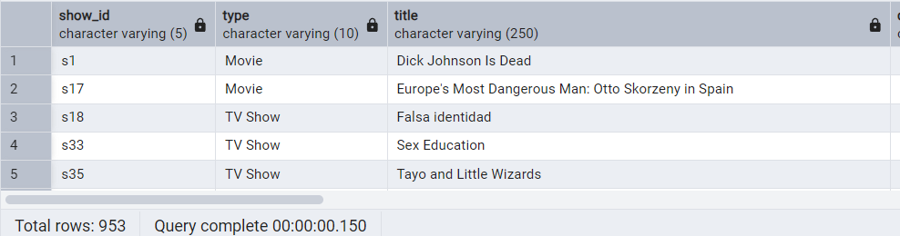

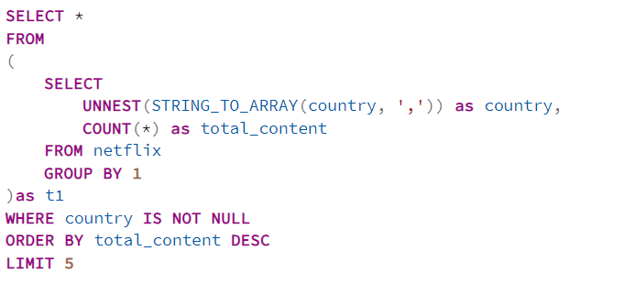
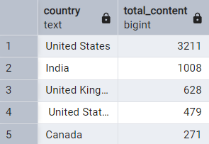
SQL Queries
3) List all movies released in a specific year (e.g., 2020)
4) Find the top 5 countries with the most content on Netflix

Slide 6
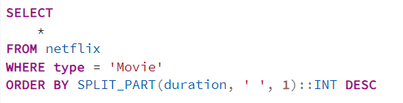
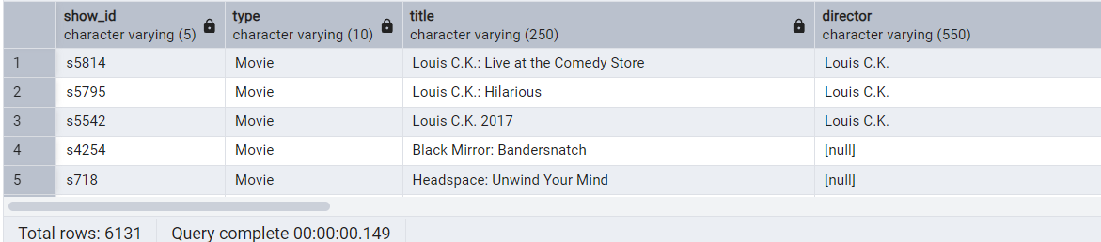
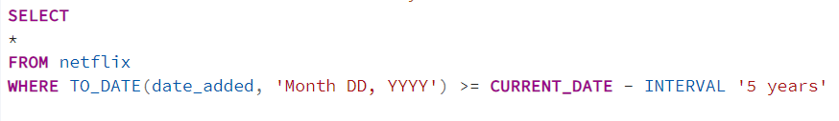
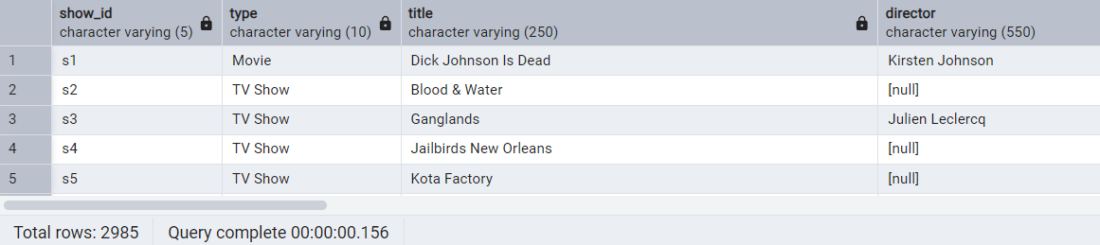
SQL Queries
5) Identify the longest movie
6) Find content added in the last 5 years

Slide 7
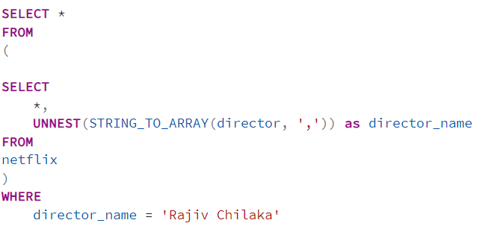
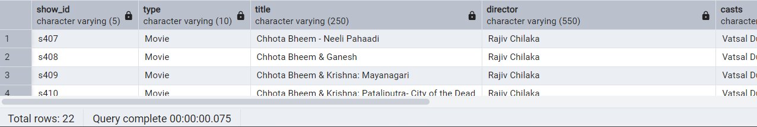
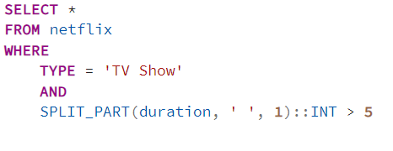
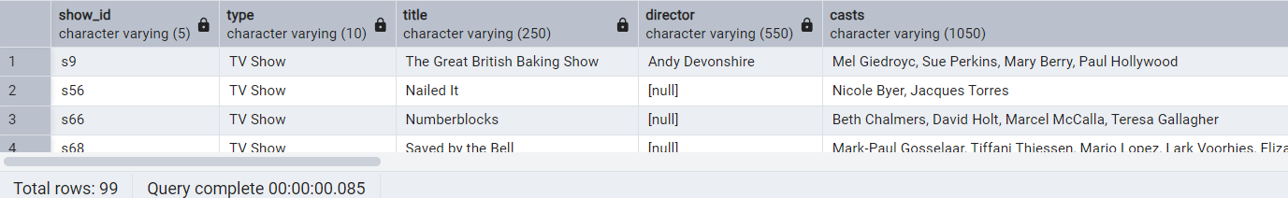
SQL Queries
7) Find all the movies/TV shows by director 'Rajiv Chilaka'
8) List all TV shows with more than 5 seasons

Slide 8
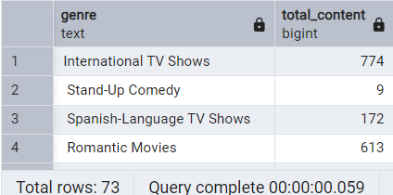
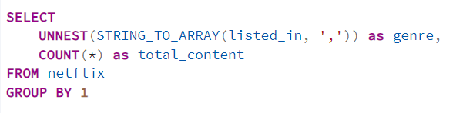
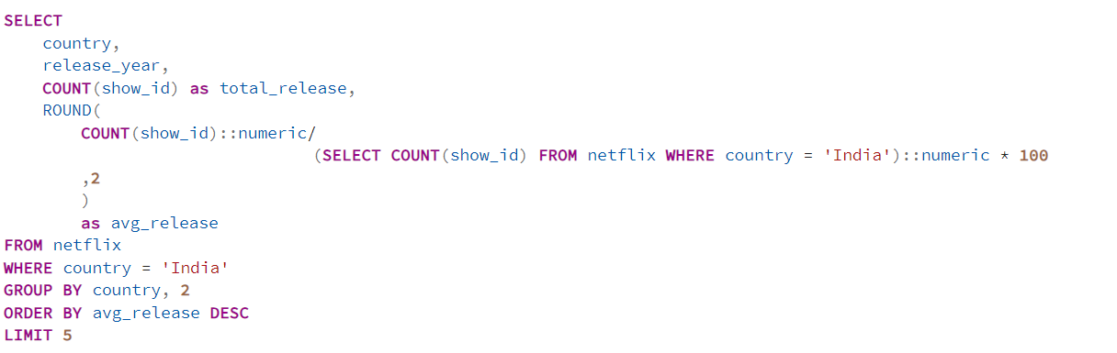
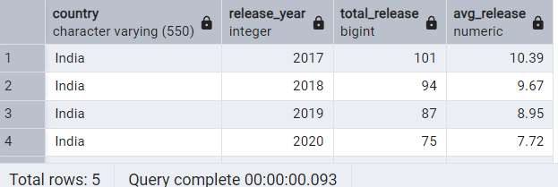
SQL Queries
9) Count the number of content items in each genre
10) Find each year and the average numbers of content release by India on Netflix return top 5 year with highest avg content release

Slide 9
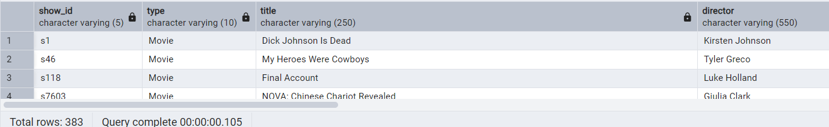

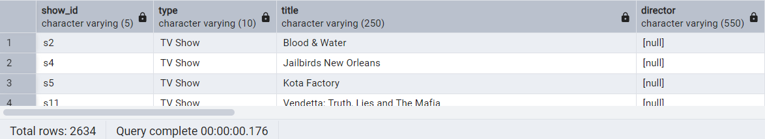

SQL Queries
11) List all movies that are documentaries
12) Find all content without a director

Slide 10
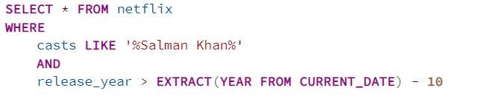
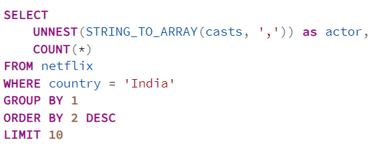
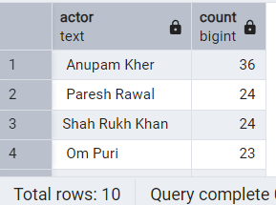
SQL Queries
13) Find how many movies actor 'Salman Khan' appeared in last 10 years!
14) Find all content without a director

Slide 11
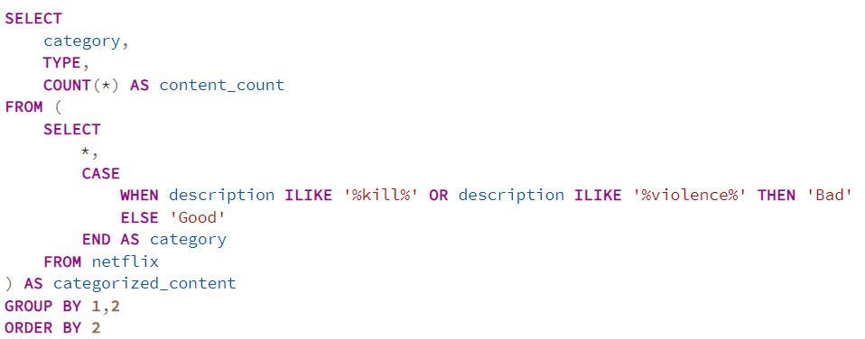
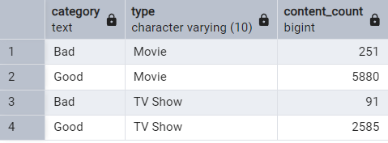
SQL Queries
15) Categorize the content based on the presence of the keywords 'kill' and 'violence' in
the description field. Label content containing these keywords as 'Bad' and all other
content as 'Good'. Count how many items fall into each category.

Slide 12
📢 Conclusion & Future Enhancements
Netflix primarily focuses on Movies, but TV shows are also a major part of its content library.
The most common ratings suggest a balance between family-friendly and mature content.
The United States dominates in content production, but international content is also growing.
Future scope: Advanced analytics using Python & Power BI for visual trends and deeper insights.
By Vaibhav Bari

